Slide 1
Automatic Sleep Stage Classification with CNN and Seq2Seq Models
Presentation for Deep Learning for Healthcare
Alan Lekah, Atri Basu, Trevor Overfelt, David John

Slide 2
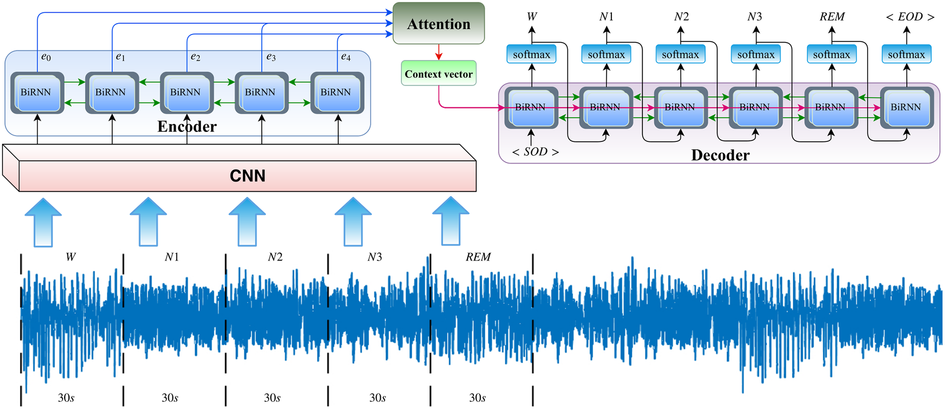
Introduction
The proposed model is based on the research performed in SleepEEGNet: Automated sleep stage scoring with sequence to sequence deep learning approach
We will present a combination architecture containing a convolutional neural network and sequence to sequence autoencoder for automatic classification of sleep stage scoring based on single channel EEG input data.
Reference architecture used in SleepEEGNet
Notes:
Problem Introduction
Quality sleep plays a vital role in proper mental and physical health, quality of life, and safety of an individual. Sleep deficiency is a very common public health problem, and an estimated 50-70 million Americans have chronic sleep disorders [5]. Reduced or abnormal sleep can lead to several physical and mental risk factors including injury/accidents, depression, and heart disease, making it a very important topic for medical research.
Sleep signals are typically recorded by placing sensors on different parts of the patient’s body. In an overnight polysomnography (PSG) (also called as sleep study), the EEG signal is usually the main collected signal being used to monitor the brain activities to diagnose different sleep disorders and other common disorders such as epilepsy.
The EEG signals are split into a number of predefined fixed length segments which are termed as epochs. Then, a sleep expert manually labels each epoch according to sleep scoring standards provided by the American Academy of Sleep Medicine (AASM)
Why use deep learning to classify sleep data?
several limitations including the need for a prior knowledge of sleep analysis and features identified in one dataset are not able to generalize to larger datasets from various patients with different sleep patterns
manual scoring of such a long signal for a sleep expert is a tedious and time-consuming task. The human-based annotation methods also highly rely on an inter-rater agreement in place
Model introduction:
Read slide

Slide 3
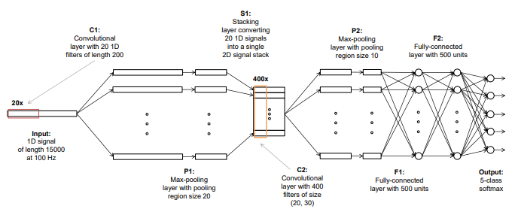
CNNs for Signal Data Feature Extraction
Convolutional Neural Networks can learn task-specific filters without needing any prior domain knowledge or complex feature engineering
Common Computer Vision applications - train a model by integrating feature extraction and classification using the raw data input (EEG signals)
Example CNN architecture from Orestis Tsinalis et al.
Notes:
Convolutional neural networks are often used in computer vision applications to automatically extract feature information from raw data without relying on prior domain knowledge
A convolutional neural network (CNN) is composed of successive convolutional (filtering) and pooling (subsampling) layers with a form of nonlinearity applied before or after pooling, potentially followed by one or more fully connected layers.
In multi-classification problems, like sleep scoring, the last layer of a CNN is commonly a softmax (multinomial logistic regression) layer.
For sleep data architectures, Polysomnography (PSG) data is collected from patients and the raw signals are split into 30s epochs (raw data is common for computer vision applications). This signal data is used as the CNN input
The following image is from Automatic Sleep Stage Scoring by Orestis et al:
Where a CNN applied to a precomputed spectrogram or other time-frequency decomposition of the signal, so that the input to the CNN is a two-dimensional (2D) stack of frequency-specific activity over time. When the spectrogram is used as input it can be treated as a 2D image

Slide 4
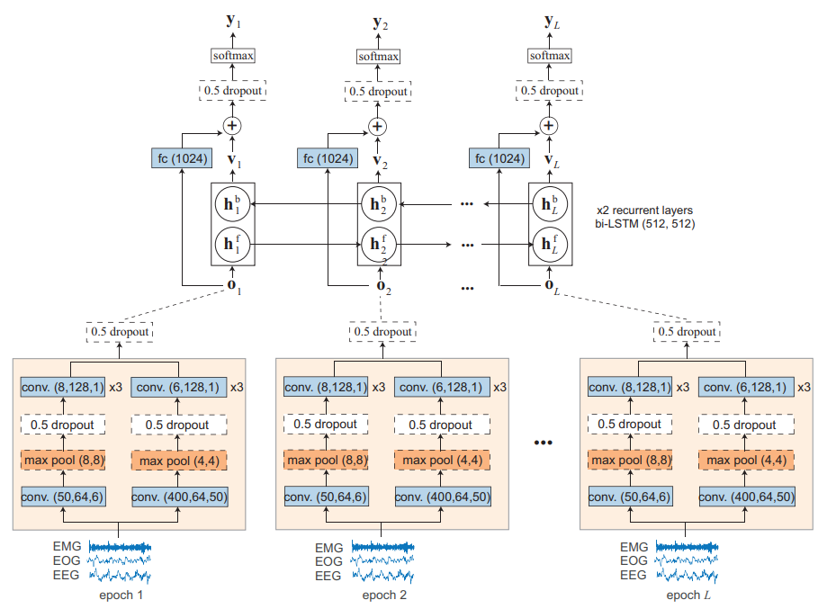
Encoder/Decoder for Sleep Data
Sequence-to-sequence models capture the complex and long short-term context dependencies between sleep epochs and scores
The encoder encodes the input sequence, while the decoder computes the category of each single channel 30-s EEG of the input sequence
Couple with feature extraction from previous CNN model to enhance classification and train end-to-end model
End-to-end Sequence-to-Sequence model used in DeepSleepNet Architecture (Supratak et al.)
Notes:
Encoder/Decoder models are used to encode the latent features of a given input into a vector representation, and reconstruct the context vector to compute the appropriate output category
Seq2Seq is a form of the encoder/decoder architecture that is used to capture time-series dependencies between the input data sequences
From SleepEEG:
The sleep is a cyclical process. Typically, a sleeper experiences five main sleep stages during his sleep time, including wake, N1, N2, N3, and rapid eye movement (REM) stages. Usually, each sleep cycle goes through the Non-REM (Stages 1, 2 and 3) sleep to REM sleep. In most cases, the cycle takes 90-120 minutes resulting in four to five cycles per night [20]. Hence, we believe the sleep stage classification problem is sequential in nature and taking into account this sequential characteristic by considering the correlation between different stages can enhance the accuracy of sleep stage scoring process.
Example image is from the successful DeepSleepNet architecture, which uses an end-to-end deep neural network including multiple seq2seq Bi-LSTM RNNs to classify sleep stage

Slide 5
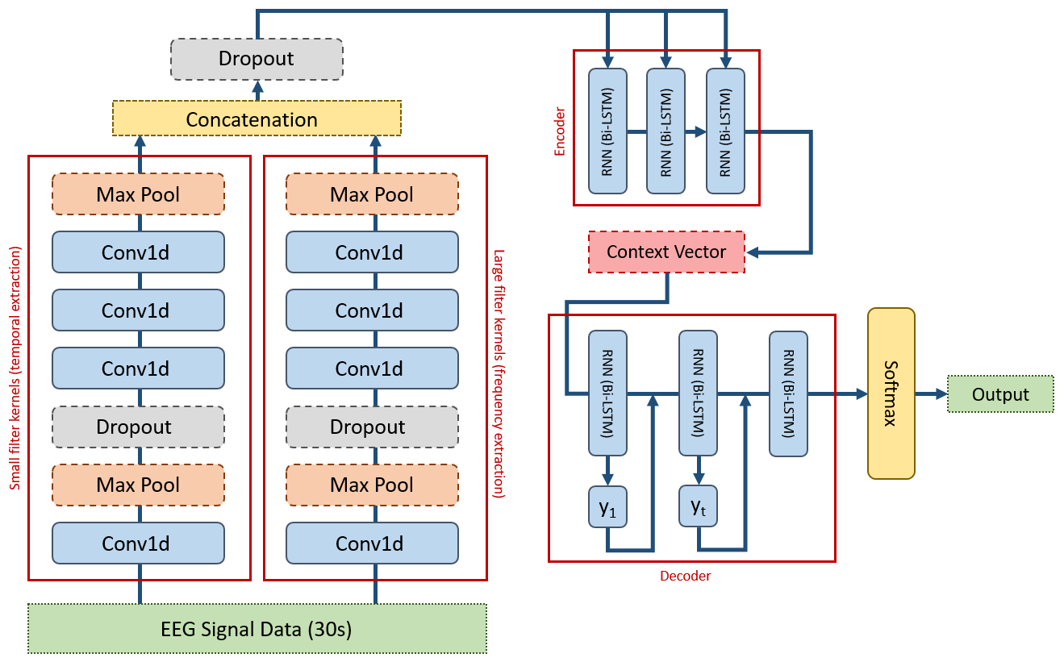
Combined Architecture (CNN + Seq2Seq)
Parallel CNNs based on reference architecture from SleepEEGNet:
Small filters - temporal information
Large filters - frequency-level information
Simple Encoder/Decoder architecture:
Trivial embedding mechanism
Sequence-level decoding + stacking
Softmax output for multilabel classification (coordinating with each sleep stage)
Notes:
The first part of our model was a CNN architecture similar to that described in the SleepEEG and DeepSleepNet sequence to sequence network . The model consists of two separate CNNs, which are run together using the same EEG epoch signal data before outputs for both models are combined for later processing. The first CNN uses smaller filter kernels in an attempt to extract temporal information from the data, and the second uses large filter kernels to extract frequency-level information. Each CNN in this model consists of four separate conv1d functions followed by ReLu nonlinear activation. The original model was written using TensorFlow was translated to PyTorch to emulate the same functionality. For each convolution and max pooling operation, the image is padded evenly on all dimensions using custom padding functions that calculated the padding length of each dimension based on the input/output size, kernel size, and stride. After all convolutions, max poolings, and activation operations were complete for both the large and small kernel CNNs, the data was concatenated over the last dimension and sent to a final dropout layer to produce the complete CNN output
The results of the CNN layers, which attempted to automatically identify the features found in our EEG signals, is then passed to a simplified sequence-to-sequence auto-encoder architecture, which utilizes the sequence structure of the data to create learnable vectors before final label classification (Pytorch Bi-LSTM). Our first state and encoder output is then passed to our decoder model, which reshaped our inputs to the appropriate size, and passes them through another GRU to reconstruct the vector with the correct values. The output of our RNN layer is then passed through multiple linear fully-connected layers and ReLu non-linear activations. The resulting vector is returned to our parent model, and concatenated to a list. This decoding process is completed for each encoded representation in the sequence, using the previous hidden state and reconstructed vector output as parameters for the newly decoded token. Once the sequence was decoded, the resulting vectors are stacked together, and passed through a final Softmax layer to produce the probabilities for each available class.

Slide 6
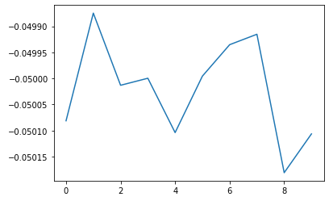
Results
Overall, the learning performance and validation of our model was fairly poor. We believe our model failed to extract and learn from the appropriate features, either due to an error with the CNN layers extracting frequency information, or the encoder/decoder finding latent representations of the sleep stages.
Some classes were excluded from classification entirely, and performance varied greatly based on the subjects that were sampled from our dataset.
 | Predicted
 | W1 | N1 | N2 | N3 | REM
W1 (116) | 4 | 33 | 73 | 6 | 0
N1 (184) | 1 | 101 | 74 | 8 | 0
N2 (402) | 10 | 204 | 171 | 17 | 0
N3 (119) | 2 | 58 | 56 | 3 | 0
REM (179) | 3 | 87 | 83 | 6 | 0
Model training performance over a few epochs

Slide 7
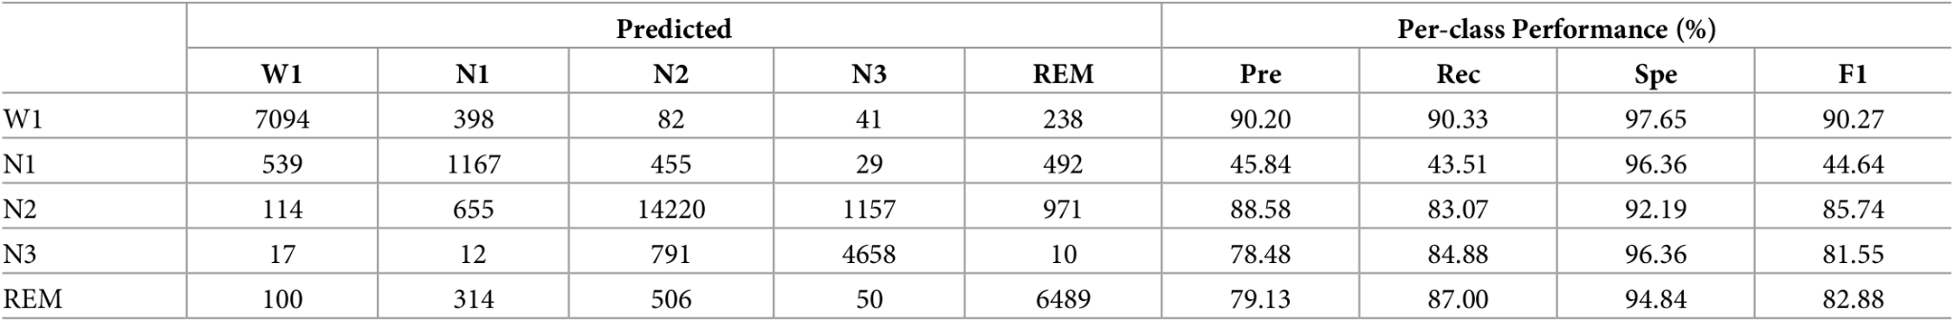
Comparison
Class-based performance metrics shown in SleepEEGNet paper
 | Predicted
 | W1 | N1 | N2 | N3 | REM
W1 | 4 | 33 | 73 | 6 | 0
N1 | 1 | 101 | 74 | 8 | 0
N2 | 10 | 204 | 171 | 17 | 0
N3 | 2 | 58 | 56 | 3 | 0
REM | 3 | 87 | 83 | 6 | 0
 | Per-class Performance (%)
 | Pre | Rec | Spe | F1
W1 | 20.0 | 3.45 | 98.19 | 5.88
N1 | 20.91 | 54.89 | 53.19 | 30.28
N2 | 37.42 | 42.54 | 52.17 | 39.81
N3 | 7.50 | 2.52 | 95.80 | 100
REM | N/A | 0.00 | 100 | N/A
Class-based performance metrics of the implemented model

Slide 8
Discussion
Several Difficulties Faced:
Handling the shape of the preprocessed data
Translating Tensorflow to PyTorch implementation
Fully-functioning sequence-to-sequence encoder/decoder
Class imbalance in SleepEDF dataset
Learning Take-away:
The architecture of the model is very important in determining learning performance. Incorrect layers, loss function decisions, or dataset splitting may lead to inappropriately learned features, which impacts classification.
Consideration and understanding of the required preprocessing steps should be well thought out. Incorrect structure of the input data leads to difficulty with size and shape as the data is passed and transformed through your model layers.
Combining multiple models into an end-to-end trained neural network is difficult, but powerful in terms of classification accuracy. It is important to verify that your gradient is being back-propagated fully to ensure proper learning.

